Slide 1
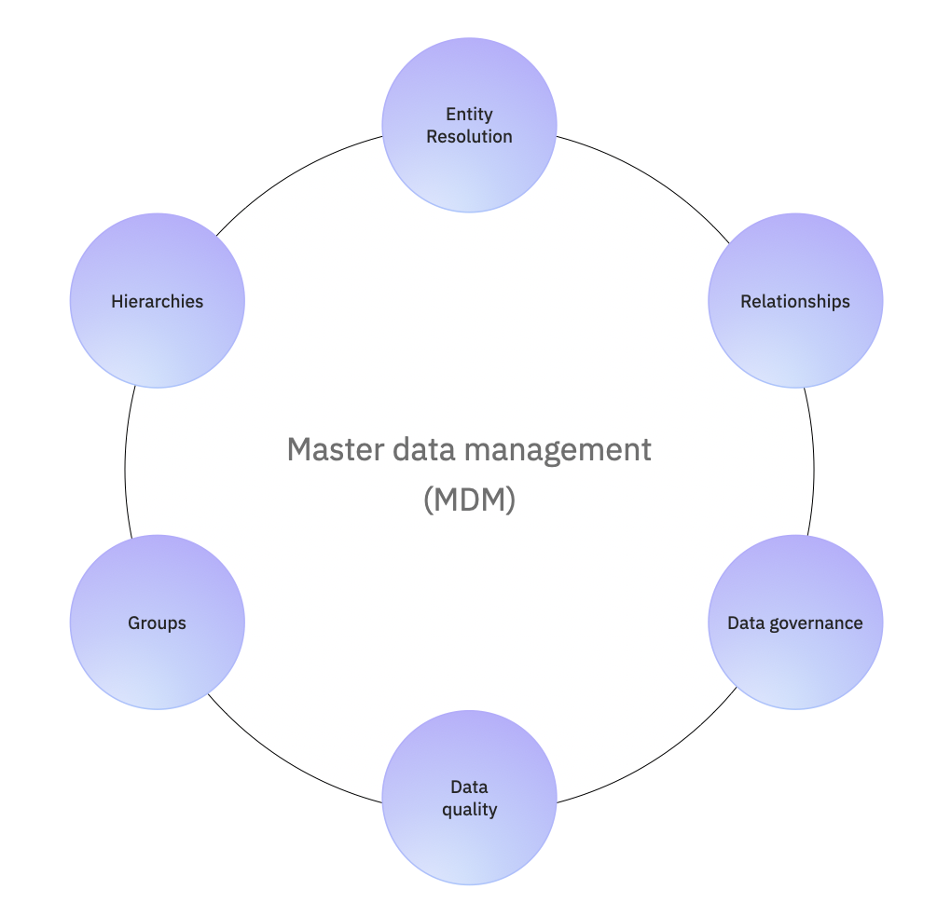
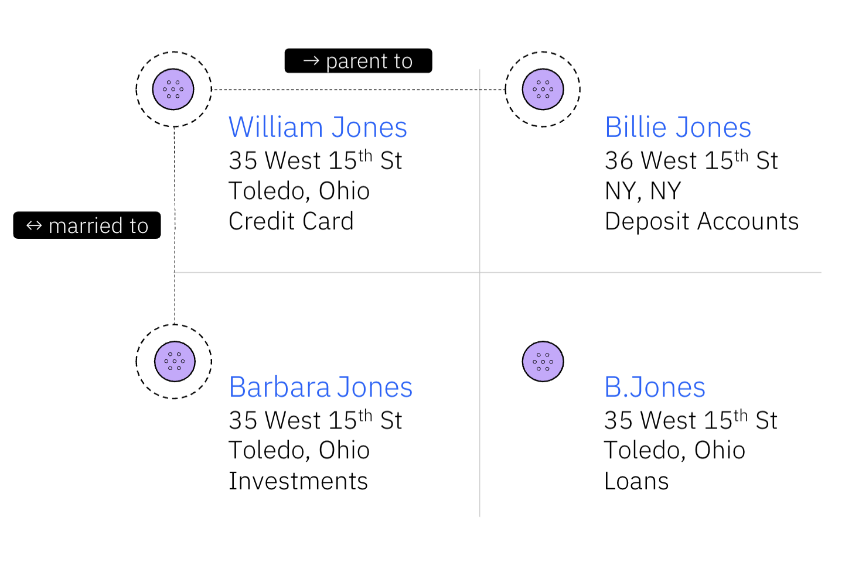
IBM Master Data Management Solutions
Vision and Roadmap

Slide 2
Disclaimer
IBM’s statements regarding its plans, directions, and intent are subject to change or withdrawal without notice at IBM’s sole discretion.
Information regarding potential future products is intended to outline our general product direction and it should not be relied on in making a purchasing decision.
The information mentioned regarding potential future products is not a commitment, promise, or legal obligation to deliver any material, code or functionality. Information about potential future products may not be incorporated into any contract.
The development, release, and timing of any future features or functionality described for our products remains at our sole discretion.
Performance is based on measurements and projections using standard IBM benchmarks in a controlled environment. The actual throughput or performance that any user will experience will vary depending upon many factors, including considerations such as the amount of multiprogramming in the user’s job stream, the I/O configuration, the storage configuration, and the workload processed. Therefore, no assurance can be given that an individual user will achieve results similar to those stated here.

Slide 3
Problems in today’s master data management programs
IBM’s Point of View for Master Data Management (MDM)
Modernizing
MDM Applications
Maintaining Existing
MDM Applications
Increasing
Return on
MDM Investments
Facing pressure in…
Modernizing MDM without breaking operational systems
Future-proofing architecture for hybrid cloud
Accelerating innovation
IBM helps solve with…
Facing pressure in…
Meeting SLAs for mission-critical workloads
Meeting CISO/BISO requirements
Managing upgrades and product lifecycle
IBM helps solve with…
Complete Stack Refresh & Improved Support
Improving the efficiency, security, and maintainability of the overall IBM MDM software ecosystem.
Facing pressure in…
Increasing data producer and consumer productivity
Monetizing master data
Democratizing use
IBM helps solve with…
Better Ways of Working
Enabling and augmenting new and better ways of working with master data assets.
Red Hat OpenShift Option
Enhancing and making available additional containerized deployment options that provide scalability, flexibility, and manageability.
Complete Stack Refresh &
Improved Support
Improving the efficiency, security, and maintainability of the overall IBM MDM software ecosystem.
Better Ways of Working
Enabling and augmenting new and better ways of working with master data assets.

Slide 4
Modernizing MDM Applications with Red Hat OpenShift Option
Supporting hybrid usage and consumption patterns
Traditional MDM (non-containerized)
Physical or virtual infrastructure
Managed Red Hat OpenShift
Cloud managed, start quickly
Red Hat OpenShift
Customer managed, maximum flexibility
Traditional MDM (non-containerized) deployed on-premises or public cloud, on physical or virtual infrastructure
Red Hat OpenShift Service on AWS (ROSA¹)
On public cloud or on-premises, on physical or virtual infrastructure
Azure Red Hat OpenShift (ARO²)
Red Hat OpenShift on IBM Cloud (ROKS)
¹ Product roadmap targeting Q2 2023
² Product roadmap targeting Q3 2023
Key Roadmap Releases
IBM Master Data Management Advanced Edition/Standard Edition (MDM AE/SE) AWS ROSA support in Q2 2023
MDM SE Microsoft ARO support Q1 2024
MDM AE Microsoft ARO support Q2 2024
Improving SLAs, optimizing infrastructure use and lowering costs and ongoing expenses
Improving Responsiveness and Downtime
Improves response times of more than 80% of features
Reduces downtime due to rolling updates and continuous delivery
Optimizing infrastructure use
App layer
Optimized CPU and memory
Infrastructure sharing across applications for improved utilization
Dynamic scaling within cluster
Platform layer
OpenShift enables consolidation to 22% fewer VMs
Lowering costs and improving efficiency
Application development
Container deployment automation for less dependency on IT Ops
29% faster application development lifecycles
Release almost 3X more new features
IT Operations
OpenShift enables IT infrastructure teams to be 21% more efficient
Managed Red Hat OpenShift Cloud Services
Reduces average development time per application up to 70%
Recoups 20% of developer time from elimination of previous infrastructure maintenance work
Increases operational efficiency by up to 50%
¹ Product roadmap targeting Q2 2023
² Product roadmap targeting Q3 2023
Notes:
https://www.redhat.com/en/technologies/cloud-computing/openshift
https://www.redhat.com/rhdc/managed-files/cl-idc-business-value-openshift-analyst-material-f28051-202104-en_1.pdf
https://www.redhat.com/rhdc/managed-files/cl-forrester-total-economic-impact-openshift-analyst-material-f31111-202202-en.pdf

Slide 5
Maintaining Existing
MDM Applications
with Complete Stack Refresh & Improved Support
Benefit from over 1 Million Person-Hours of Development Enhancements
Complete
Stack Refresh¹
Latest innovations
Platform Updates
Supporting Program Updates
Security Enhancements
Higher Value
Licenses
Key Roadmap Releases:
New Major Release (v14) in 1H 2024
Resets support lifecycle maintenance clock
New Extended Support offering in Q3 2023
Optional additional 4 years of support (+1+3)
New Advanced Support offering in Q3 2023
Priority care support beyond standard S&S
Higher case prioritization and target responsiveness
Advanced Support Focal (ASF)
OS
Hypervisors
Containers
Databases
MQ
BPM
WAS
And many more
Full stack
Bundled Programs
Supporting Programs
Red Hat OCP
Latest versions
¹ Product roadmap for next major release (v14)

Slide 6
Increasing Return on
MDM Investments with Better Ways of Working
Providing key functionality and master data products for Data Fabric and AI use cases
Self-Service
Expose self-service matching to LOB users
AI-infused
(stewardship, engine tuning, …)
Time-to-Value
Configure – don’t code
Model-driven configuration using JSON API / Graph Database
Built-in Governance
Data quality, privacy & protection happens automatically
Policy-driven enforcement
Future Proof
Run anywhere
Microservices, containers
Lower TCO
Same skills as other capabilities on
Cloud Pak for Data
Cross-product same install, upgrade, backup & restore, etc.
Key Roadmap Releases – Match 360
Snapshot enhancements; asset mapping and advanced composite view in Q1 2024
Source-level threshold support in Q1 2024
Match Statistics view enhancements in Q2 2024
After-failure controls and configurations in Q2 2024
Increasing return on data investments through accelerating productivity and monetization, while democratizing master data use
Productivity
Automate master data product creation through pipeline orchestration
Rolling, non-disruptive updates with back-up and recovery
Stream real-time entity data, enabling easy and consistent downstream consumption
Seamlessly enforce governance and data protection through rules and policies
Monetization
Publish and Sync assets with IBM MDM Publisher from MDM AE/SE with Cloud Pak for Data without costly and cumbersome data replication and integration jobs
Consume and Integrate synced assets along with new master data assets using modern REST APIs
Democratization
Provide stewardship and data quality with reasoning for why entities were matched, and remediate and review issues through automated workflows
Customize and tune the algorithm and entity views to meet unique use cases
An easy-to-use experience to get users the data they need, at the right time

Slide 7
IBM MDM Roadmap Timeline
IBM MDM AE/SE and Match 360
Recent releases 3&4Q 2023
1Q 2024
2Q 2024
2H 2024- 1H 2025
MDM AE Microsoft ARO support
Ongoing RHOCP EUS Version Update and Support and container hardening
Red Hat OpenShift Option
IBM Master Data Management Advanced Edition/Standard Edition (MDM AE/SE) AWS ROSA
Complete Stack Refresh and Improved Support
New advanced and extended support offerings
v14
MDM AE/SE stack refresh
MDM AE/SE major release
Graph search, discovery, and relationship management
Data Quality Management– Ease of Use Enhancements w/ Dashboard, Explainability, Smart Trigger etc.
Persisted entity enhancements
Audit and hierarchy management
Change history management
Address standardization/verification interface integration
Entity lineage via MANTA
Match 360 available on SaaS
Record filtering
Glue record thresholds
Enhanced attribute composition
Performance and stability improvements
Advanced real-time data streaming (delta load)
Snapshot enhancements; advanced composite view and asset mapping
Ongoing sync with Kafka
Source-level threshold support
Match Statistics view enhancements
After-failure controls and configurations
Better ways of working
Note - IBM’s statements regarding its plans, directions, and intent are subject to change or withdrawal without notice at IBM’s sole discretion.

Slide 8
MDM AE SE Stack Refresh
OS, Hypervisor,
Containers, Security
Application Server, Middleware, BPM
Database Services
Data Quality, BI,
Integration
Operating System
      Red Hat Enterprise Linux (RHEL) 9.2
      AIX 7.3 TL1
      Hypervisor
      VMWare ESXi 8.0
Red Hat OpenShift Container Platform (OCP) EUS Version 4.12
MDM container security hardening
IBM Security Directory Suite 8.0.1
      Critical enabler for enterprise security
Add support for WebSphere Application Server 9.0.5.15
IBM SDK, Java Technology Edition, Version 11
Rational Application Developer for WebSphere Software, Version 9.7.0.5
Kafka 3.4.0
      IBM Business Automation Workflow 21.0.3 (LTSR) - next suitable LTSR version
MDM Advanced Edition
      Amazon RDS for Oracle
      Oracle Database 21c
      IBM Db2 13 for z/OS
      IBM Db2 11.5.8
MDM Standard Edition
      SQL Server 2022 for Microsoft Windows
      Oracle Database 21c
      IBM Db2 v11.5.8
      SQL Server on Azure (SaaS)
MDM SE support for latest versions of JDBC/ODBC Data Direct Drivers
IBM InfoSphere Information Server 11.7.1.4
      IBM Cognos Analytics 11
      IBM App Connect Enterprise 12.0.7.0

Slide 9
Master Data Management
Drive faster and scalable insights by delivering a single and comprehensive view of an entity’s data across an enterprise
Data sources
IBM Master Data Management
Match 360, MDM Advanced and Standard Editions, Product Master
watsonx.data
Data science
Connect and match data at scale
Streaming and real-time data
IBM DataStage
ETL and cleansing
Business insights
Real-time enterprise application integration
IBM Data Product Exchange
Batch loading
Marketing and sales
Match, merge, and link data across sources
Data marketplace
Metadata
IBM Knowledge Catalog
Data discovery
Data quality management
Automated data lineage
Data protection
Data Fabric / © 2023 IBM Corporation
Notes:
This use case enables organizations to create a trusted and protected business-ready data foundation, it addresses:
Knowing your data – establishing data governance
Trusting you data – Providing easy access to quality data
Protecting your data – Autonomous enforcement of data and AI governance policies
Using your data – Enabling self-service assess to trusted data

Slide 10

Put AI to work with watsonx
Scale and accelerate the impact of AI with trusted data.
Leverage foundation models to automate data search, discovery, and linking in watsonx.data
watsonx.ai
watsonx.data
watsonx.governance
Train, validate, tune and deploy AI models
Scale AI workloads, for all your data, anywhere
Enable responsible, transparent and explainable AI workflows
Leverage governed enterprise data in watsonx.data to seamlessly train or fine-tune foundation models
Enable fine-tuned models to be managed through market leading governance and lifecycle management capabilities
Notes:
This three components work in concert to scale and accelerate the impact of your AI workflows with trusted data

Slide 11
Simplify data access and utilization across the enterprise with a data fabric architecture
Scale and accelerate the impact of AI with trusted data
Data Fabric
AI and data platform
watsonx™
watsonx.ai™
watsonx.data™
watsonx.governance™
Data Governance and Security
Automate management of data lifecycles with governance, security and lineage for self-service data consumption
IBM Knowledge Catalog
IBM Guardium Security
Data Integration
Provide readily consumable and properly governed data to your teams anytime and anywhere
IBM DataStage, IBM Data Replication IBM Data Virtualization
Data Product as a Service
Data Observability
Deliver reliable data by detecting data incidents earlier and resolving them faster with continuous data observability
IBM Databand
Master Data Management
Drive faster and scalable insights by delivering a single and comprehensive view of an entity’s data across an enterprise
IBM Master Data Management
IBM Match 360
Notes:
But as we know, and as I have already mentioned, It is also critical to deliver trusted data because AI is only as good as the data that fuels it.
IBM enables clients simplify access and consumption of data for AI workflows by leveraging a data fabric architecture
With this architecture, clients automate the discovery, enrichment and discovery with our data governance capabilities, employ various data integration styles to deliver reliable data for AI workflows
This architecture is composable, allowing IBM to meet clients wherever they are in the data journey

Slide 12
Notes:
This slide is self-explanatory and requires not speaker notes.

